Slide 1
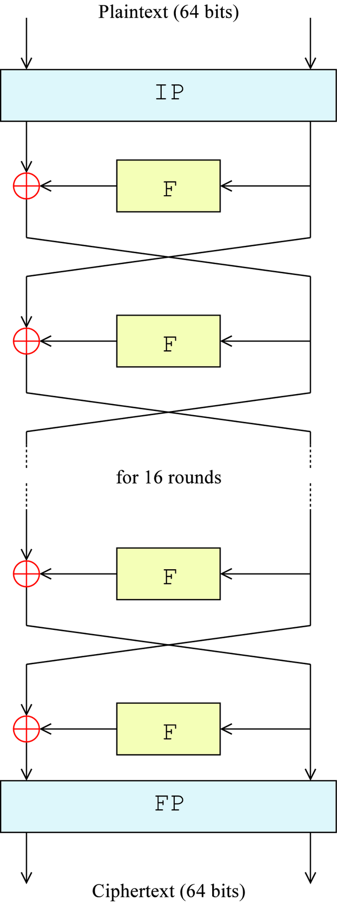
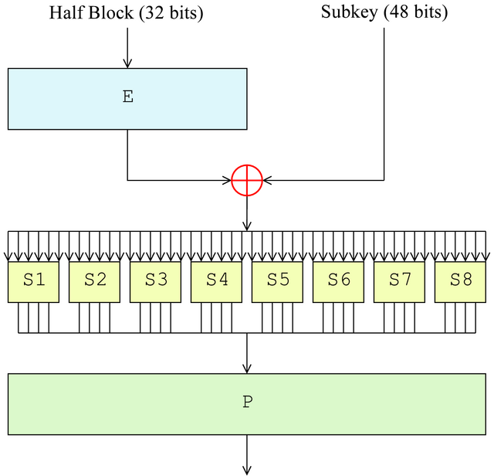
Teaching Machines to break Symmetric Key Encryption
AlphaGo used machine learning to beat human players at a game with 10^360 permutations… That’s three time the size of the AES-256 keyspace...
Mike Robeson
Can Neural Nets do differential cryptanalysis and break modern day cryptosystems that protect us in our online lives?
Supervised by Sasa Radomirovic & Jianguo Zhang
Encryption encodes data, using a key, to hide information. Can Neural Networks detect & exploit weakness(es) in modern cryptosystems? Can they “break” systems that protect us every day?
Copy this text box for any sections of text you wish to use. Font is the University’s official font - Baxter Sans 28 point.
Symmetric key process
Don’t put in too much text - use LESS than is on this template - a good balance of clear, informative text and images is ideal. Have a look at posters from previous years to see what works and what doesn’t work.
DES encryption process
Encodings to test:
Simple ciphers – Substitution, Caesar, Multi-time pad
Data Encryption Standard (DES) – ECB mode
Using Tensorflow
Four tests proposed:
Is this encrypted or random data? – Classification
Which key made this encrypted data? – Classification
Model the full crypto-system – Regression
Extract the key – Regression
Note regarding colours: it is recommended that you use predominantly black text with grey for any text which is less important. Text to be highlighted should be done using ONE of the four colours from the Computing logo, which are:
Blue: R=0 G=107 B=181 Green: R=99 G=189 B=41 Orange: R=255 G=132 B=41 Pink: R=198 G=49 B=107 Grey: R=195 G=195 B=195
These colours can be copied from above (using Format Painter), or set via Font Colors / Custom
Results:
Consistently >50% accuracy for simple ciphers and DES components, many test results >90%
Nets struggled with multiple DES rounds
Need to “remember” previous outputs
DO NOT SUBMIT a PDF, JPG or other format – leave as a PPTX!!!
The Feistel Function (F)
Future Work:
Further component & rounds testing
Classification of cryptosystems – Which encryption used? Which system most/least secure?
CNNs, LSTMs, GANs & NTMs Networks – Key approx., Sequential data, fake data, model computational operations
Do not allow any text, image or shadow to go below this level
Do not allow any text, image or shadow to go below this level

